Slide 1
Custom Geometry
03/05/2021
Gaetano Dilevrano (gaetano.dilevrano@polito.it)

Slide 2
Content
Import custom geometry from FEMM
Custom geometry simulations
Save a custom machine

Slide 3
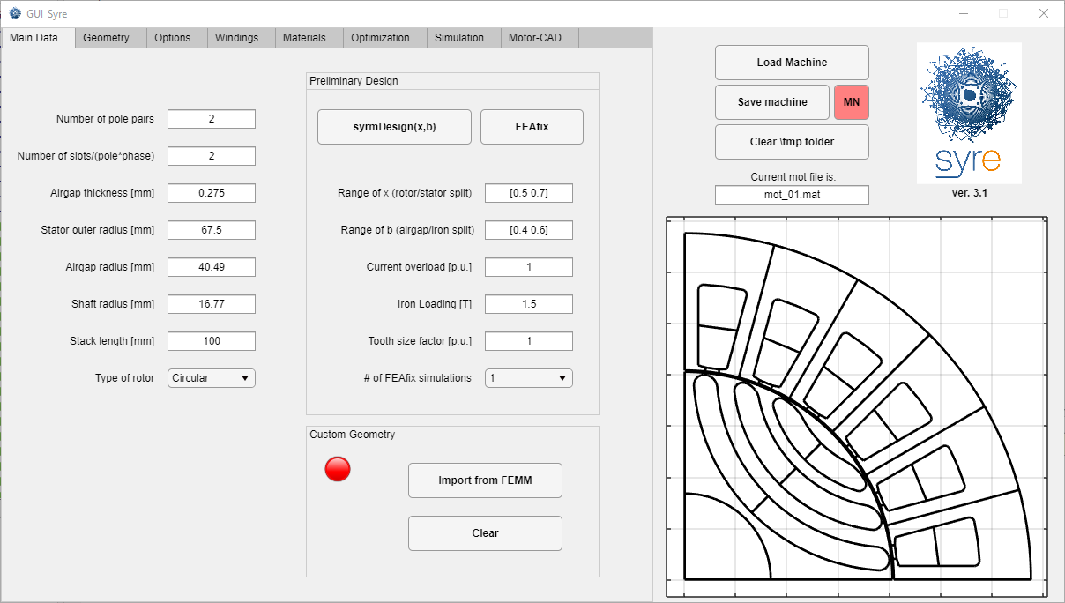
Custom geometry panel
In GUI_Syre , a new panel in the Main tab for Custom Geometry features is added.

Slide 4
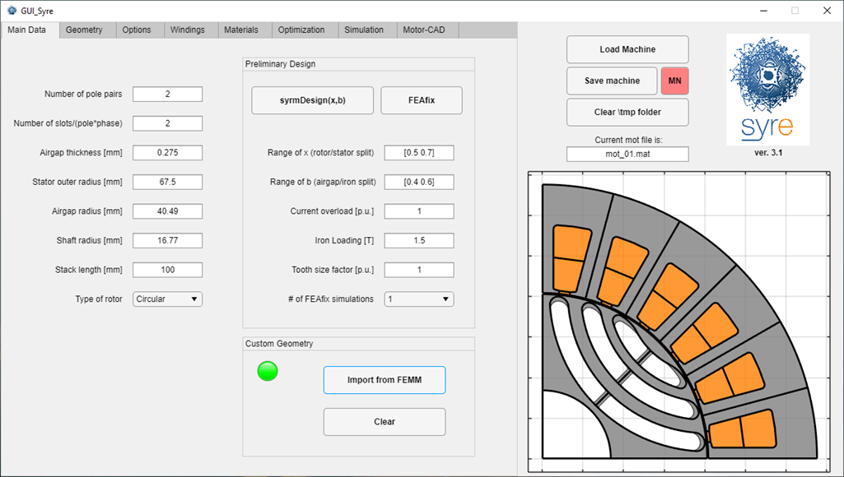
Custom geometry panel
The button Import Geometry from FEMM, run the function customDraw.m and the custom machine is plotted in color in the GUI. SyR-e geometry is overlapped on the custom one.

Slide 5
Custom geometry import
When a custom geometry is correctly imported, 2 new variables are created in dataSet:
custom: is a flag equal to 1 if the geometry is custom, else is equal to 0;
pShape: is a structure that contains information about the custom geometry in terms of MATLAB polyshape variables.

Slide 6
Custom geometry clear
The Clear button, restores the SyR-e geometry and deletes all custom properties.

Slide 7
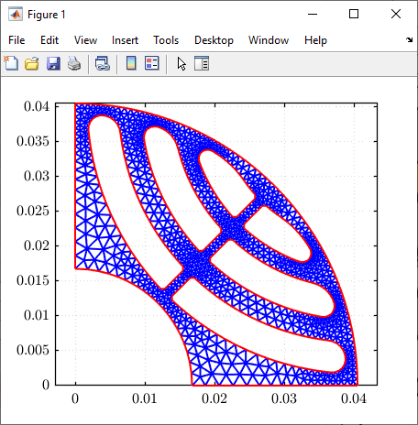
Custom geometry simulations
If a custom machine is loaded, all simulations run analysis on the custom geometry. In particular, the figure below shows a structural analysis performed on the custom machine of the previous slides.

Slide 8
Save a custom machine
To save a custom machine, use the Save machine button. A popup ask to confirm the saving operation. If Yes is selected the custom machine is saved in the chosen destination.
Note: the machineName.mat file contains the information about the SyR-e geometry (except for new custom variables).

